Slide 1
DATA SCIENCE Intro to Data Science

Slide 2
I. What Is A Data Scientist? II. Data Science Workflow
AGENDA

Slide 3
I. What is A Data Scientist?
INTRO TO DATA SCIENCE

Slide 4
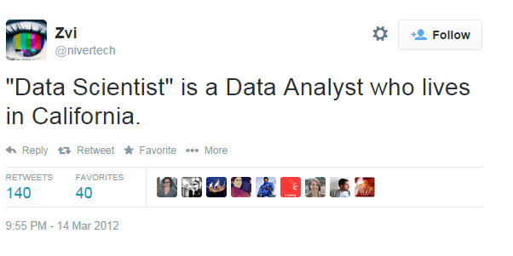
WHAT IS A DATA SCIENTIST?

Slide 5
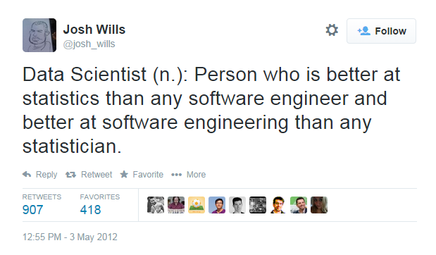
WHAT IS A DATA SCIENTIST?

Slide 6
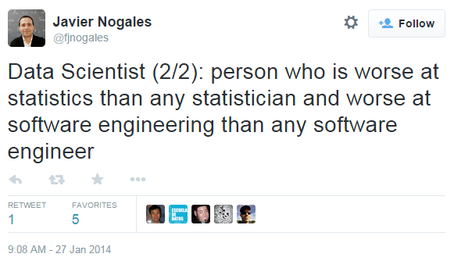
WHAT IS A DATA SCIENTIST?

Slide 7
What Is your definition?
WHAT IS A DATA SCIENTIST?

Slide 8
WHAT IS A DATA SCIENTIST?
“Data Scientists are people with some mix of coding and statistical skills who work on making data useful in various ways.”
Data Scientist Type A (for Analysis):
Primarily concerned with making sense of data or working with it in a fairly static way.
Similar to a statistician, but knows all the practical details of working with data that aren't taught in statistics: data cleaning, dealing with large data sets, visualization, domain knowledge, etc.
Source: https://www.quora.com/What-is-data-science/answer/Michael-Hochster

Slide 9
WHAT IS A DATA SCIENTIST?
“Data Scientists are people with some mix of coding and statistical skills who work on making data useful in various ways.”
Data Scientist Type B (for Building):
Some statistical background, but strong coder or software engineer.
Primarily concerned with using data “in production”: building models which interact with users (by giving recommendations, for example).
Our course is focused primarily on Type A.
Source: https://www.quora.com/What-is-data-science/answer/Michael-Hochster

Slide 10
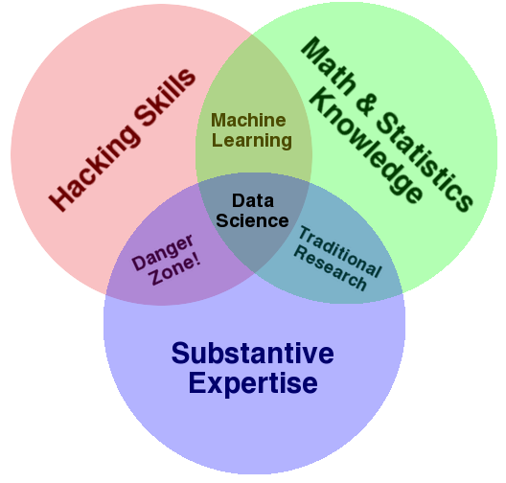
WHAT IS A DATA SCIENTIST?
Wide variance in terms of skillsets: many job descriptions are more appropriate for a team of data scientists!
Source: http://drewconway.com/zia/2013/3/26/the-data-science-venn-diagram

Slide 11
WHAT IS A DATA SCIENTIST?
Hadley Wickham’s advice for becoming a data scientist:
Statistical knowledge
“I think you need some knowledge of specific statistical/machine learning techniques, but a deep theoretical understanding is not that important. You need to understand the strengths and weaknesses of each technique… The vast majority of data science problems can be solved by a creative assembly of off-the-shelf techniques, and don't require new theory.”
Source: https://gist.github.com/hadley/820f09ded347c62c2864

Slide 12
WHAT IS A DATA SCIENTIST?
Hadley Wickham’s advice for becoming a data scientist:
Programming skills
“You need to be fluent with either R or Python. There are other options, but none of them have the community that R and Python have, which means you'll need to spend a lot of time reinventing tools that already exist elsewhere.”
Source: https://gist.github.com/hadley/820f09ded347c62c2864

Slide 13
WHAT IS A DATA SCIENTIST?
Hadley Wickham’s advice for becoming a data scientist:
Domain knowledge
“…A data scientist should be able to contribute meaningfully to any project, even if you're not intimately familiar with the specifics. I think this means you should be generally well read… and an able communicator. A good data scientist will help the real domain experts refine and frame their questions in a helpful way. Unfortunately I don't know of any good resources for learning how to ask questions.”
Source: https://gist.github.com/hadley/820f09ded347c62c2864

Slide 14
WHAT IS A DATA SCIENTIST?
Chris Volinsky (Columbia & AT&T Labs) on “Data Mining vs. Statistics”
Snark: Data Mining = Statistics + Marketing
Statistics is known for: well-defined hypotheses used to learn about a specifically chosen population studied using carefully collected data providing inferences with well-known properties.
Data mining isn’t that careful. It is: data-driven discovery of models and patterns from massive and observational data sets.
Source: http://www2.research.att.com/~volinsky/DataMining/Columbia2011/Slides/Topic1-DMIntro.ppt

Slide 15
Ii. data Science Workflow
INTRO TO DATA SCIENCE

Slide 16
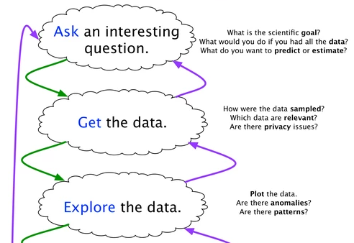
The data Science WORKFLOW

Slide 17
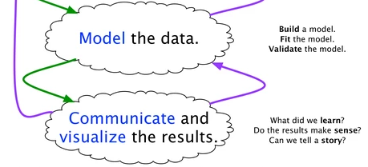
The data Science WORKFLOW
Source: https://www.quora.com/What-is-the-work-flow-or-process-of-a-data-scientist-analyst-and-what-tools-do-you-use-for-this/answer/Ryan-Fox-Squire

Slide 18
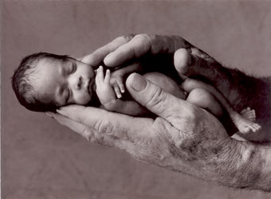
Example #1: Predicting Neonatal Infection
Problem: Children born prematurely are at high risk of developing infections, many of which are not detected until after the baby is sick
Goal: Detect subtle patterns in the data that predicts infection before it occurs
Data: 16 vital signs such as heart rate, respiration rate, blood pressure, etc…
Impact: Model is able to predict the onset of infection 24 hours before the traditional symptoms of infection appear
Image: http://www.babycaretips4u.com/wp-content/uploads/2014/03/premature-baby.jpg
Case Study: http://www.amazon.com/Big-Data-Revolution-Transform-Think/dp/0544002695

Slide 19

Example #2: Automating Government Paper-Pushing
Problem: Processing disability claims at the Social Security Administration is a time-intensive process, with many claims taking over 2 years to adjudicate
Goal: Automate the approval of a subset of the “simplest” disability claims
Data: Free text in the claims form
Impact: Able to fully automate 20% of the simplest claims. Rating accuracy of the algorithm is higher than the average claims examiner.
Case Study: http://datamininglab.com/images/case-studies/ERI_Text_Mining_SSA_Claims_for_Disability_Approval.pdf

